Slide 1
How to make the request option in Primo include only Pickup Location Home Delivery and not a real library
Yoel Kortick
Senior Librarian

Slide 2
Introduction
Before the change
Configuring the change
Try it out with the new configuration

Slide 3
Introduction

Slide 4
Introduction
During specific circumstances it may be desired by the institution to set up the request policy to be that the end user can make a request and only choose “Home delivery” (Personal delivery).
The institution in this case does not want to allow a “pickup location” of the request to be a real library.
This presentation will show how this may be achieved.

Slide 5
Before the change

Slide 6
Before the change
In a typical situation when a user makes a request he or she will have the option to choose a pickup location and perhaps also choose home delivery.
For example on the next two slides we see that after clicking “Request” the end user can choose a pickup location of either “Main Library” or “Home Address”

Slide 7
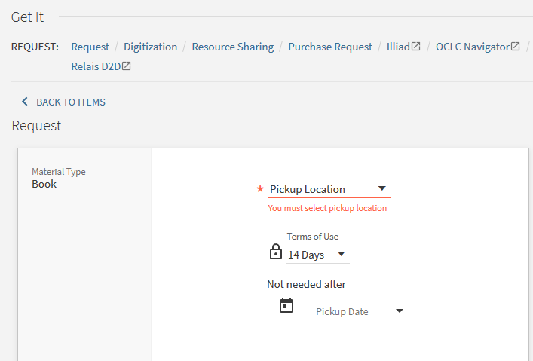
Before the change

Slide 8
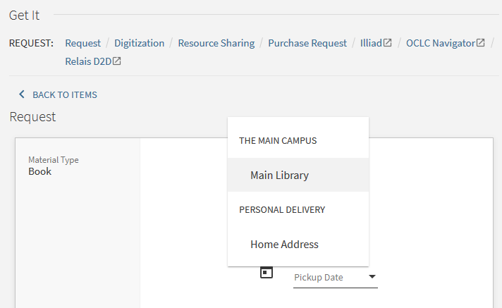
Before the change

Slide 9
Configuring the change

Slide 10
Configuring the change
Here is what we will do in this section (pictures follow):
Make the default Terms of Use (TOU) used for requests be requestable and include the option of “Home Delivery”
At “Fulfillment > Physical Fulfillment > Terms of Use and Policies” filter by “Terms of Use Type” = “Request” and edit the default.
Confirm in the TOU that “Personal delivery” is defined as either “All”, “Home” or “Office”. It should not be “None”. You can instead edit a different terms of use (not called “Default”) as long as later it will be applied to the default rule for request.

Slide 11
Configuring the change
Confirm that “Personal Delivery” is now an option.
See which locations appear as pickup locations.
For each location which will appear as a pickup location remove “has hold shelf” from the circulation desks of the library.

Slide 12
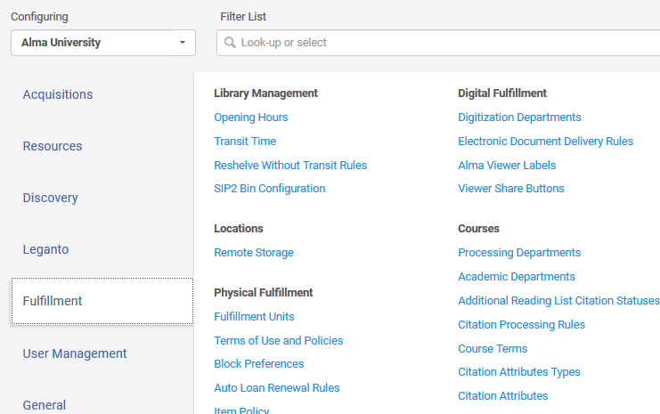
Configuring the change
Navigate to the TOUs

Slide 13
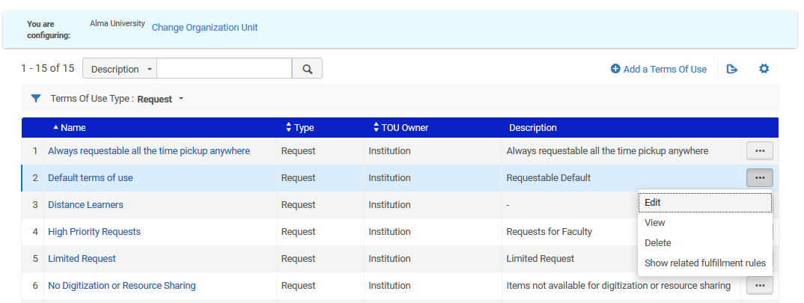
Configuring the change
Edit the default TOU of type “Request”

Slide 14
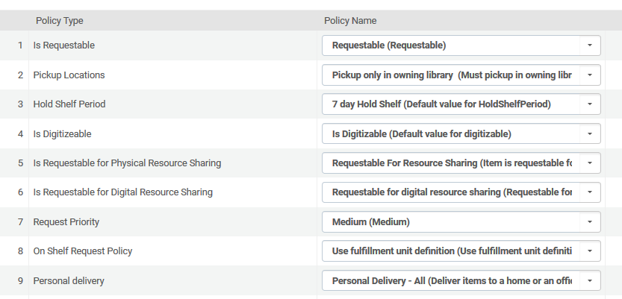
Configuring the change
Make sure it is requestable and also includes home delivery (Personal delivery)

Slide 15
Configuring the change
In the Fulfillment Unit switch to the “Fulfillment Unit Rules” tab and filter by Rule Type = Request.
Deactivate all rules except for the Default Rule.
Make sure the default uses the Terms of Use described above with “Personal delivery” defined as “All”, “Home” or “Office”.

Slide 16
Configuring the change
Access the Fulfillment Unit

Slide 17
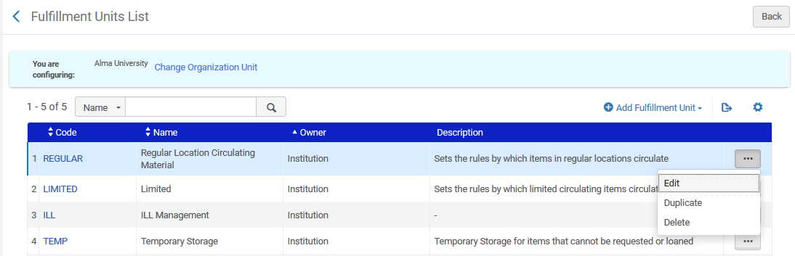
Configuring the change
Edit the Fulfillment Unit

Slide 18
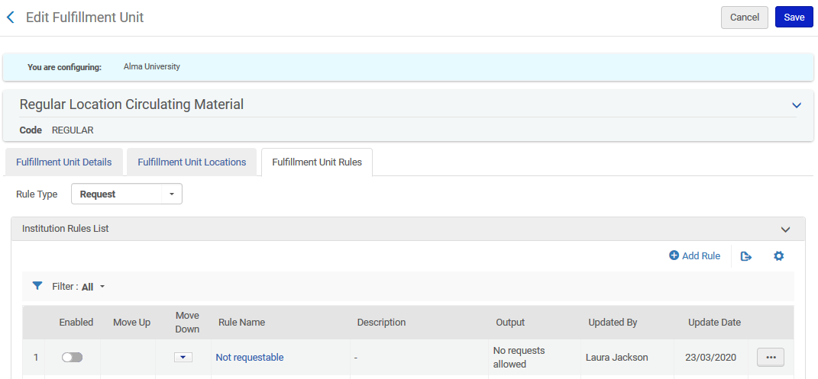
Configuring the change
Switch to Fulfillment Unit Rules tab and filter by rule type “Request”

Slide 19
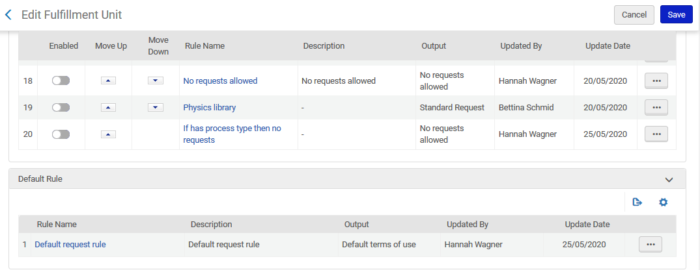
Configuring the change
Deactivate all rules except the default

Slide 20
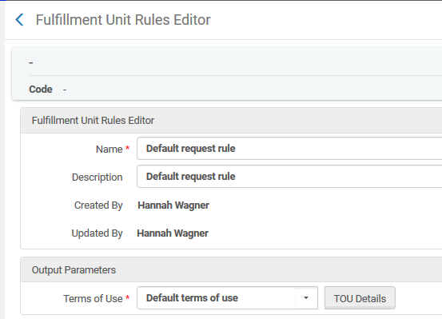
Configuring the change
Make sure default rule uses default TOU which we made sure has “requestable” and “Personal Delivery” allowed
We will now check the TOU details

Slide 21
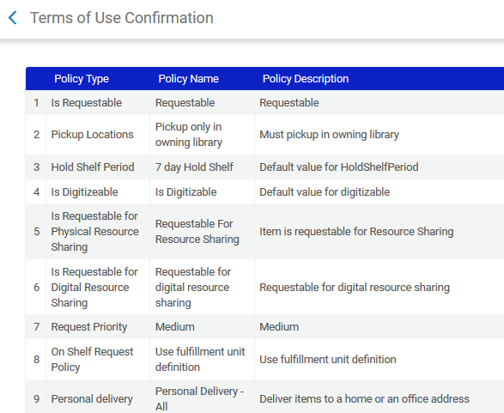
Configuring the change
Definitions are correct

Slide 22
Configuring the change
Now we will:
Confirm that “Personal Delivery” is now an option when a request is made.
See which locations appear as pickup locations (so we know what to remove).
Search Primo as logged in user for title “City women : contemporary Taiwan women writers” and click “request”

Slide 23
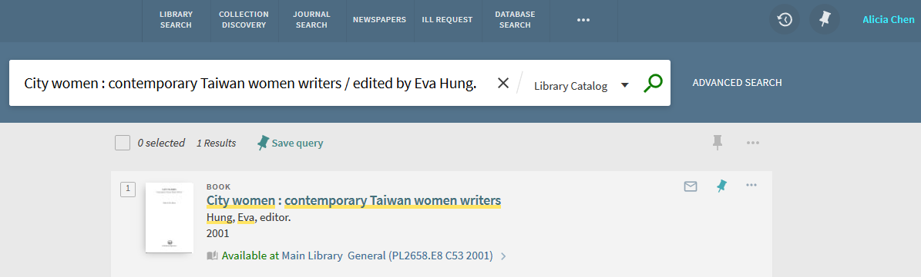
Configuring the change
User is logged in

Slide 24
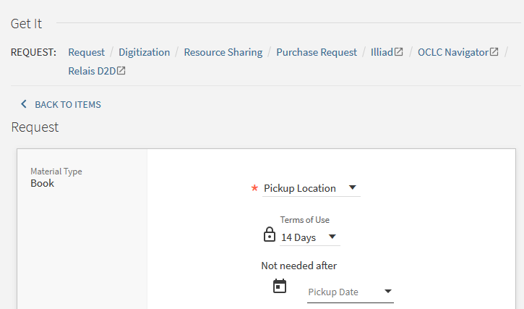
Configuring the change
Click “request” and check what Pickup Locations appear

Slide 25
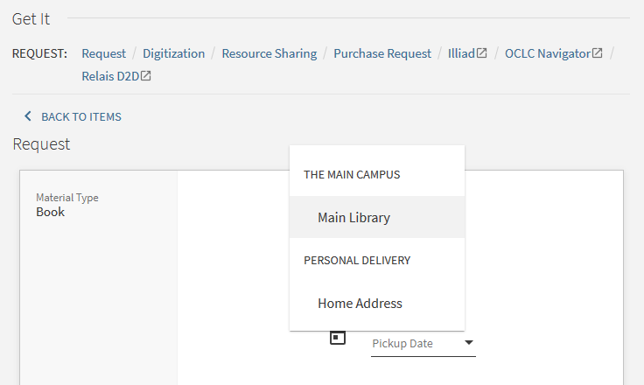
Configuring the change
Personal delivery correctly appears. We must remove “Main Library”

Slide 26
Configuring the change
We will now navigate to the circulation desks of the Main Library, and uncheck “Has Hold Shelf”.
“Configuration > Configure for specific library > Fulfillment > Library management > Circulation Desks”
This should be done for all libraries which we want to remove (in our case we had only “Main Library”).
When “Has Hold Shelf” is unchecked in all circulation desks of the library then the pickup location will be removed.

Slide 27
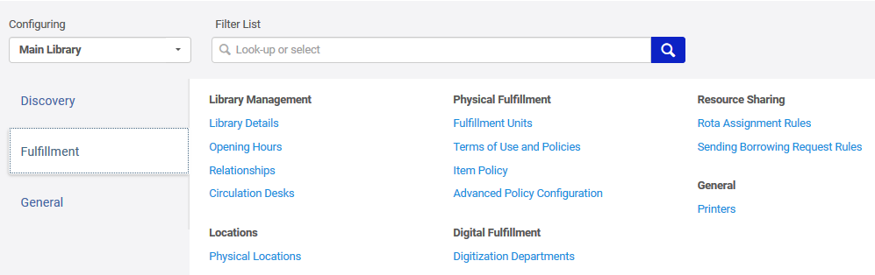
Configuring the change
Configuration > Configure for specific library > Fulfillment > Library Management > Circulation Desks

Slide 28
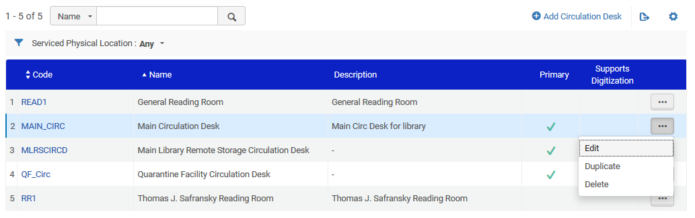
Configuring the change
Edit the Circulation Desks to uncheck “Has Hold Shelf”

Slide 29
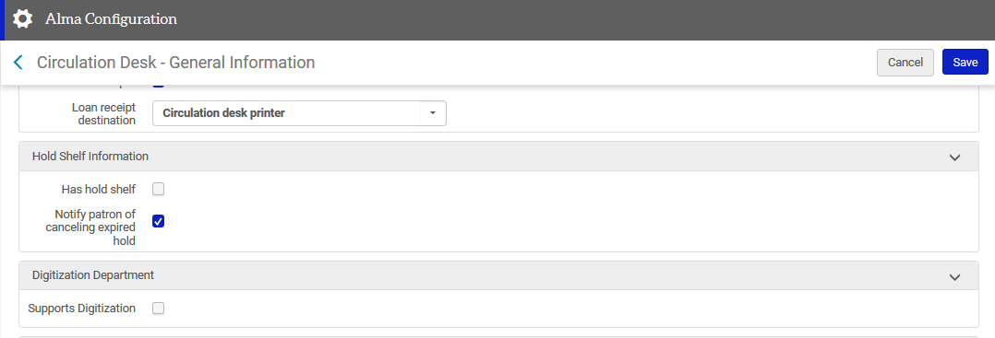
Configuring the change
Uncheck “Has Hold Shelf”

Slide 30
Try it out with the new configuration

Slide 31
Try it out with the new configuration
User Alicia Chen logs into Alma and searches for City women : contemporary Taiwan women writers / edited by Eva Hung.
She clicks the Availability link.

Slide 32
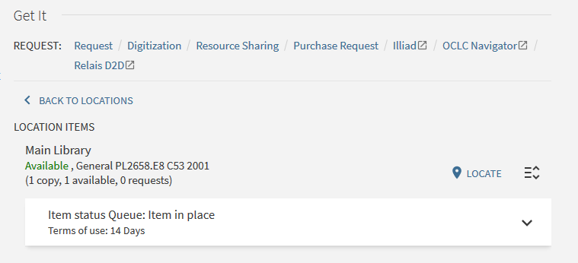
Try it out with the new configuration
She clicks “Request”

Slide 33
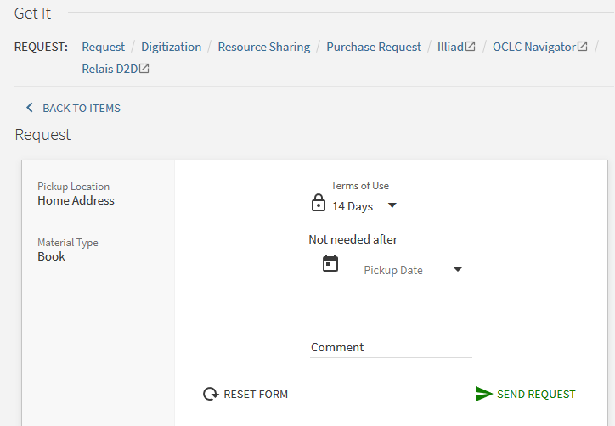
Try it out with the new configuration
Success. The only pickup location is “Home Address” and there is no option to choose a different pickup location.
Alicia sends the request

Slide 34
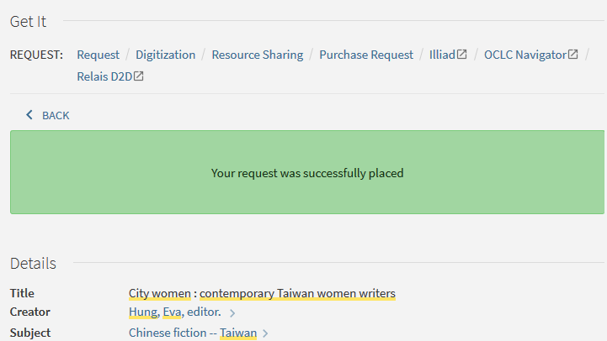
Try it out with the new configuration
The request is placed

Slide 35
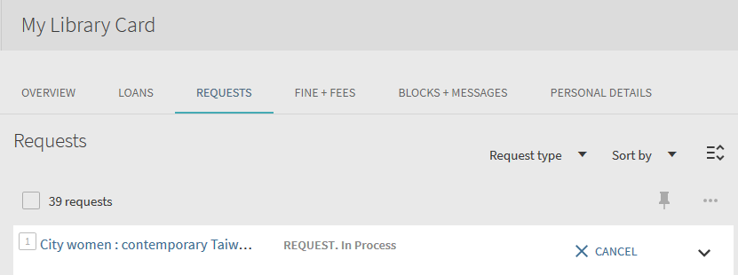
Try it out with the new configuration
Here is the Request in Alicia’s Primo Library Card

Slide 36
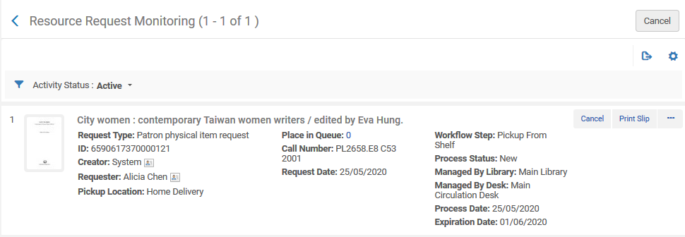
Try it out with the new configuration
Here is the Request in Alma

Slide 37
Thank you!
xxx@exlibrisgroup.com

